Slide 1
Static Code Analysis on HTML: htmlhint
Personal Performance Application
Team on a Cob
Andrew Leach

Slide 2
Overview
Since our project is web-based, I decided it was best to test the html code that I have worked with.
*Side node: We usually design in html and convert to pug for our dynamic data usage since html is easier to work with (not space sensitive)
Usage:
  htmlhint <filename.html>
More information available on their repository at: https://github.com/yaniswang/HTMLHint

Slide 3
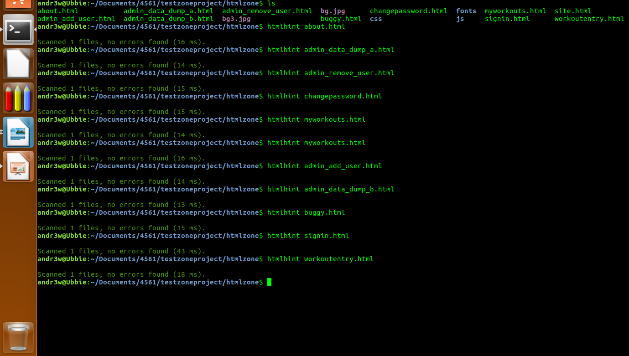
Results

Slide 4
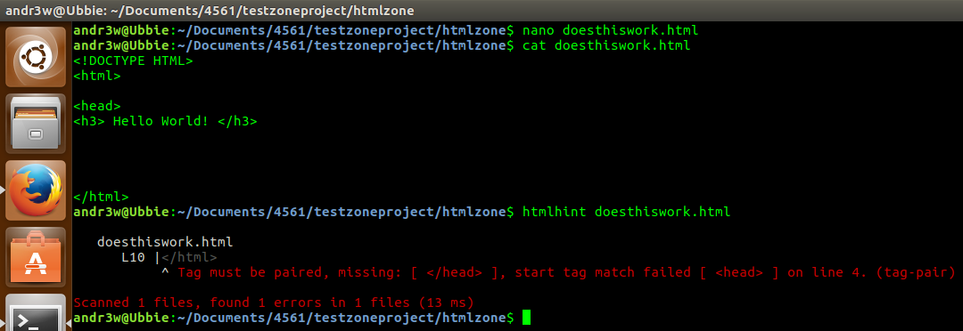
Everything Appears to Work! (Currently)
Created a test HTML file with an intentional error (missing header closing brace) and htmlhint caught the error with the missing tag error, even matched with the correct line number. Neat!

Slide 5
Final Conclusion
HTML files can get overwhelming large relative to the sophistication of a page. Using htmlhint ensures that every brace has a proper closing brace.
Without proper closing brace, attributes can linger and further cause the page to not look right, which may or may not interfere with usage.
  Example: Missing a </form> closing brace will not even allow a form to be submitted
Our HTML code can change frequently depending on the additions we make to it.
This is important for our big pages:
  Workoutentry
  Training Log

